Slide 1
CMPS 439 PROJECT
You must exactly follow this template.
Do not change the order and the format.
No background coloring or formatting.
Team Regular

Slide 2
Requirements
Develop a database system with the requirements listed below.
At least, 6 tables, at least 20 attributes in total.
Each table must have some tuples with NULL.
The total number of records must be no less than 100. The data must have diversity.
The data in tables must utilize cardinality of 1:1, 1:N, and the structural constraints of (0,N) and (1,1).
ER diagram must specify structural constraints (min, max).
Weak entity and binary or ternary relations must be used.
All drawing must be done professionally
Submit
Presentation file. Use the template PPT file Project.pptx.
Data in an Excel file. The Excel file must have single table per sheet. The first line must have attributes. Use the template Excel file Tables.xlsx.
The SQL-query file Queries.sql. Use the template file.
Backup of your database as CMPS439_<team name> and submit as "CMPS439_< team name>.bak" file.

Slide 3
TEAM MEMBERS & ROLES
Sofiat Adeyemi
ROLE: Queries QM2 - QM8.2, Business Description and Requirements, Powerpoint.
Alameen Adeku
ROLE: Queries QD1 - QM1.3, Queries QM9.1 - QM11, Powerpoint .

Slide 4
DESCRIPTION OF BUSINESS
Our project is an Online Bookstore (name to be decided) that allows users to browse, purchase, and review books. The system will support multiple categories, including fiction, non-fiction, academic books, and e-books. Customers can create accounts, track their orders, and receive book recommendations based on their purchase history.
Business Operations
Book Browsing & Searching – Users can search for books by title, author, genre, or ISBN.
Order Processing – Customers can add books to their cart and complete purchases.
User Management – Customers can create accounts, save preferences, and track orders.
Inventory Management – The system updates stock levels when books are sold.
Payment Processing – Secure online payments through credit cards, PayPal, etc.
Business Requirements
The system must store book details (title, author, genre, price, stock quantity).
Customers should be able to create accounts and track their purchase history.
Payments must be securely processed and linked to orders.
The inventory should be automatically updated after each sale.
The system should generate sales reports for analysis.

Slide 5
REFERENTIAL-RELATIONS
<Be sure that FK must match PK as instructed in the class.>
FOREIGN TABLE (REFERENCING TABLE) | REFERENCED TABLE | FOREIGN KEY | PRIMARY KEY
Reviews | Customer | CustomerId | Id
Reviews | Books | BookId | Id
OrderDetails | Orders | OrderId | Id
OrderDetails | Books | BookId | Id
Orders | Customer | CustomerId | Id
Payments | Orders | OrderId | Id
Customer Profile | Customer | CustomerId | CustomerId
Books | Publisher | PublisherName | ID
Payments | Books | BookId | Id
BookEdition | Books | BookId | ID

Slide 6
REFERENTIAL-RELATIONS
<Be sure that FK must match PK as instructed in the class.>
FOREIGN TABLE (REFERENCING TABLE) | REFERENCED TABLE | FOREIGN KEY | PRIMARY KEY
BookPromotion | Customer | CustomerId | PromotionId
BookPromotion | Books | BookId | PromotionId
BookPromotion | Publisher | PublisherName | PromotionId

Slide 7
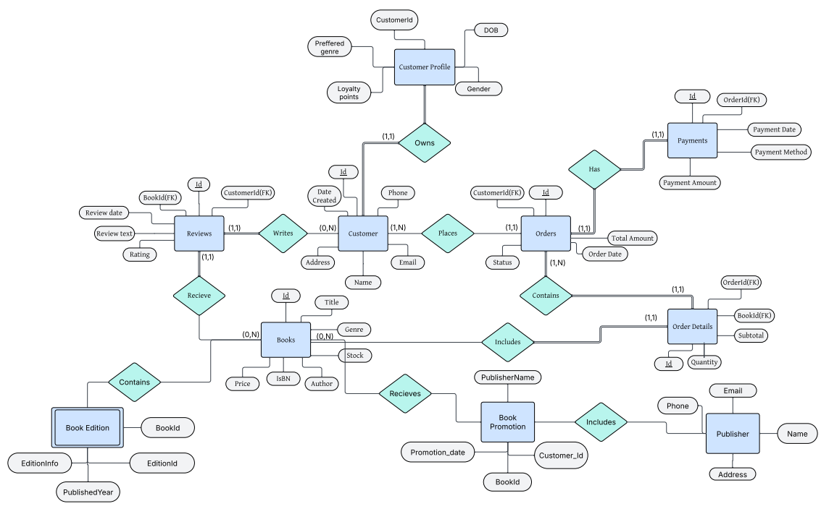
ER-Diagram

Slide 8
DDL QUERIES
Instructions:
- must include ALL queries listed in Queries.sql
- must follow the exact format provided in the template slide

Slide 9
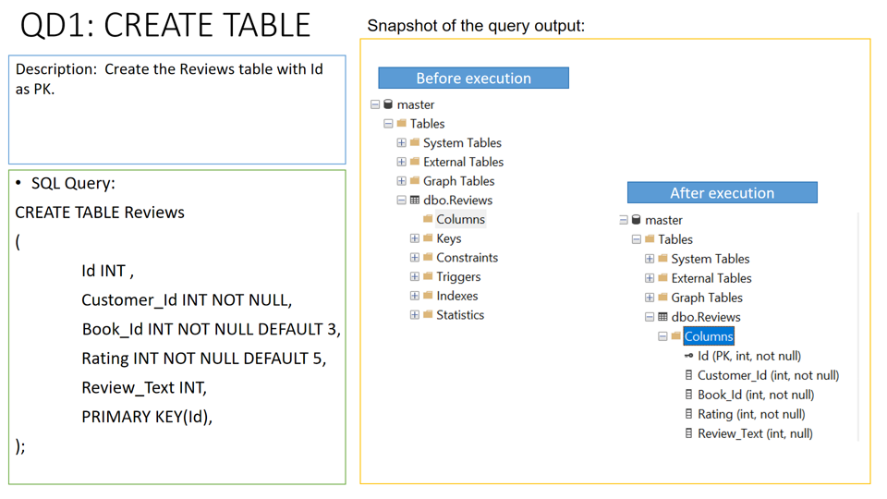

Slide 10
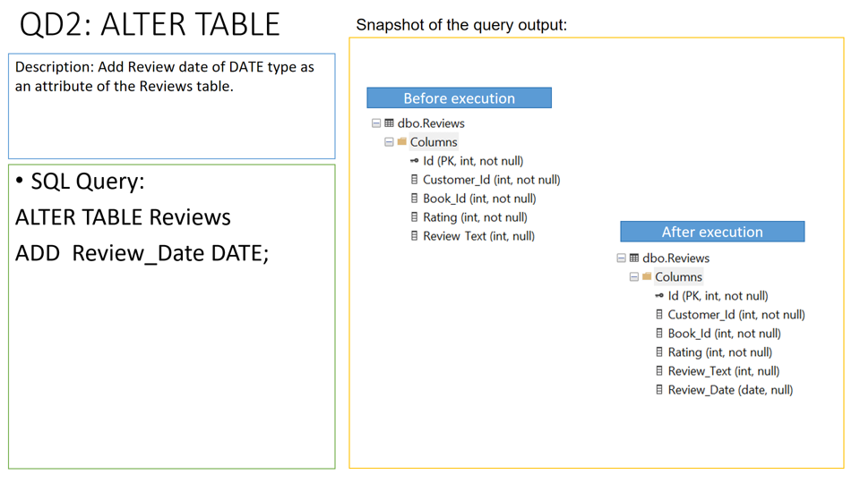

Slide 11
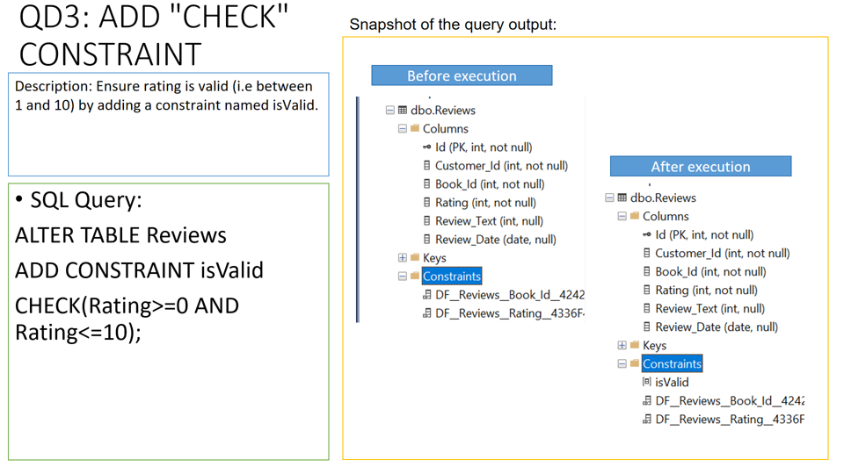

Slide 12
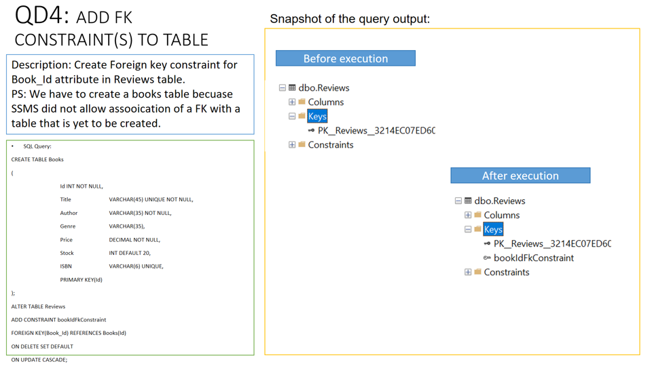

Slide 13
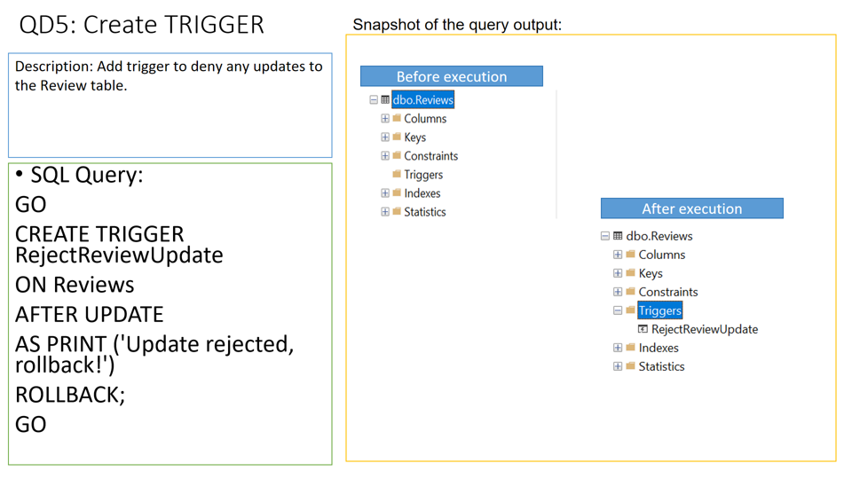

Slide 14
DML QUERIES
Instructions:
- must include ALL queries listed in Queries.sql
- must follow the exact format provided in the template slide

Slide 15
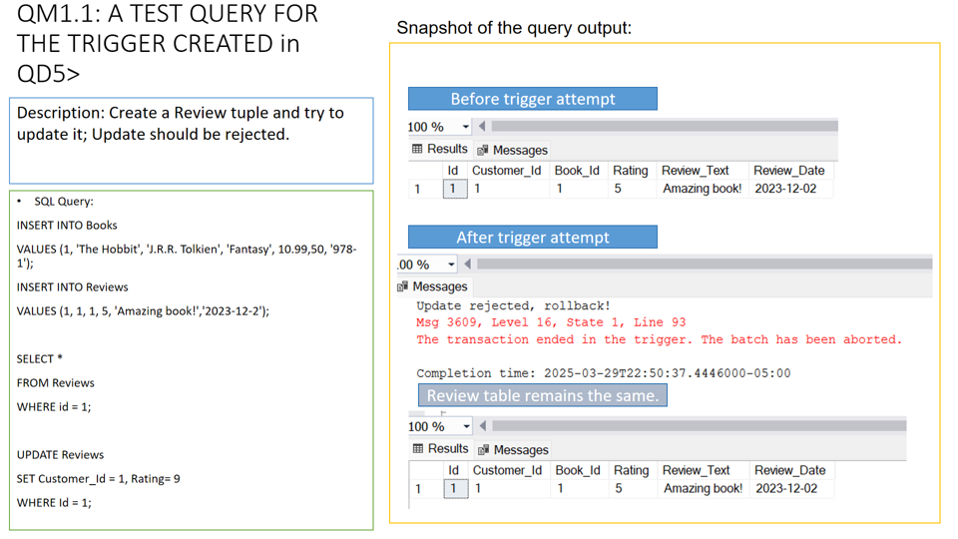

Slide 16
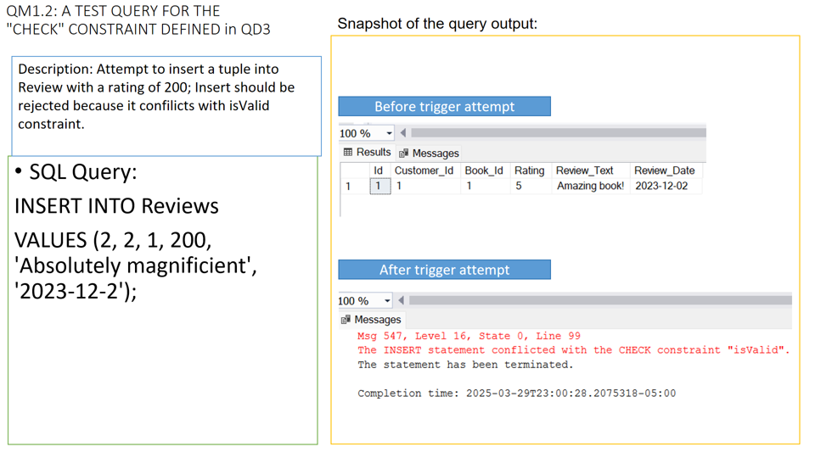

Slide 17
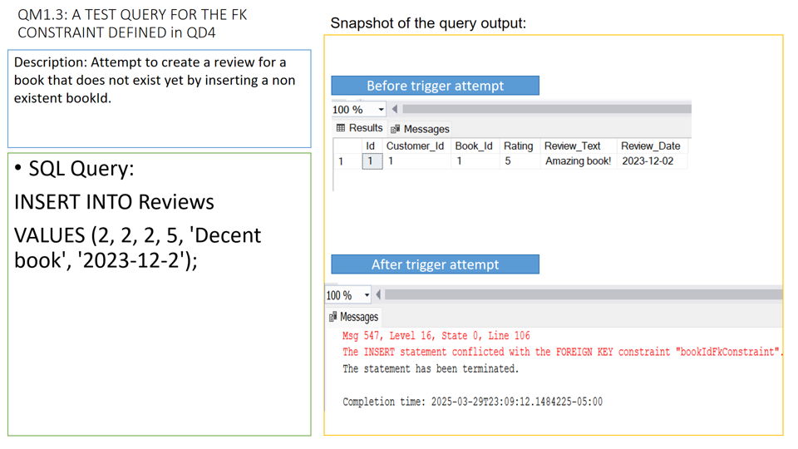

Slide 18
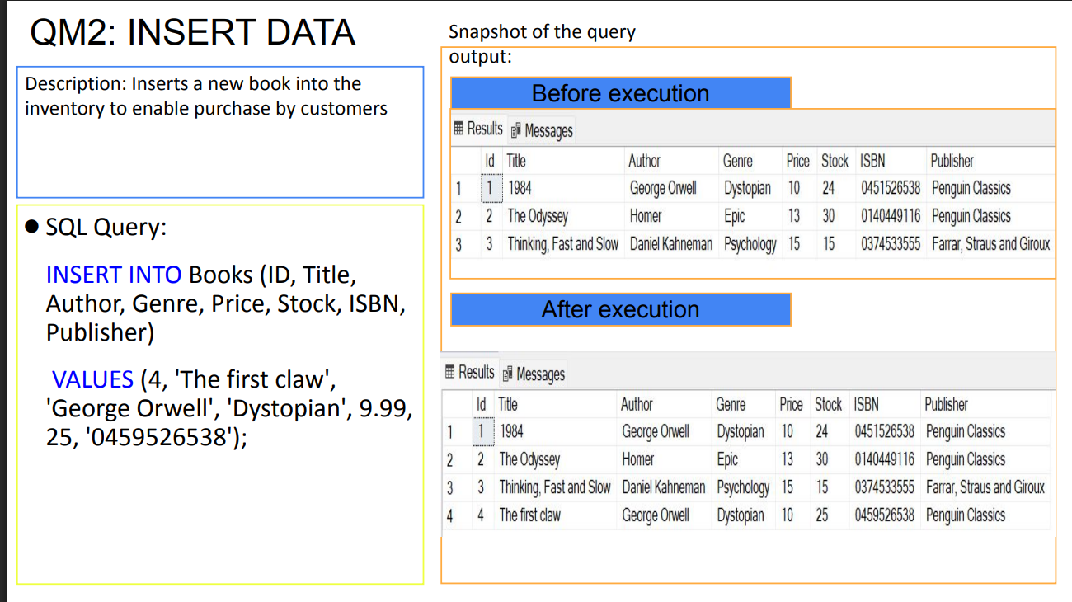

Slide 19
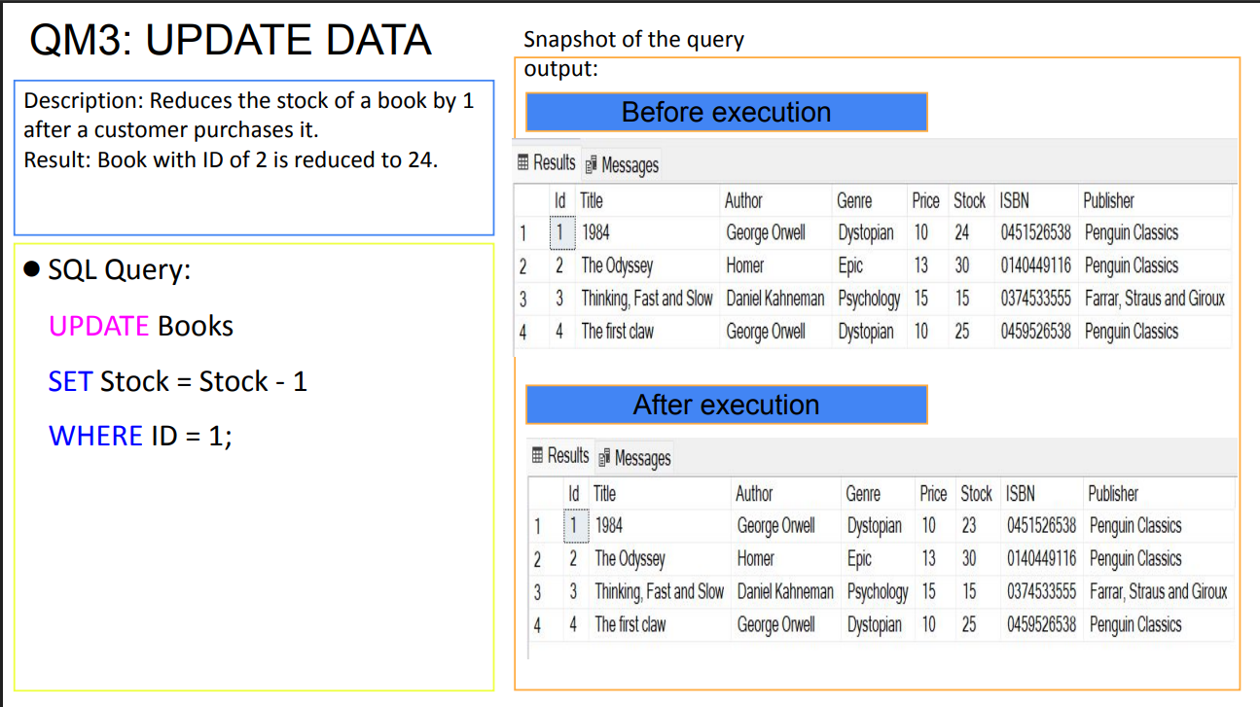

Slide 20
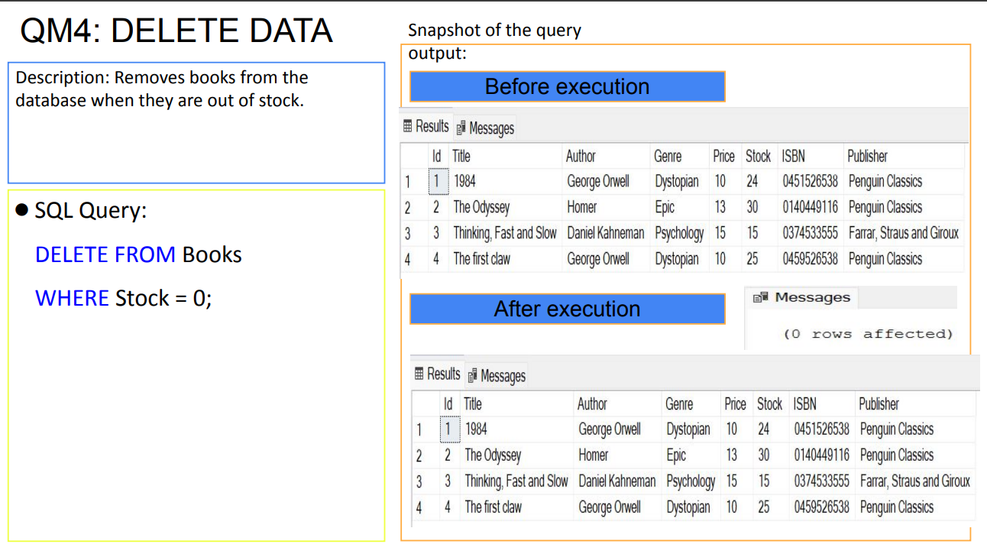

Slide 21
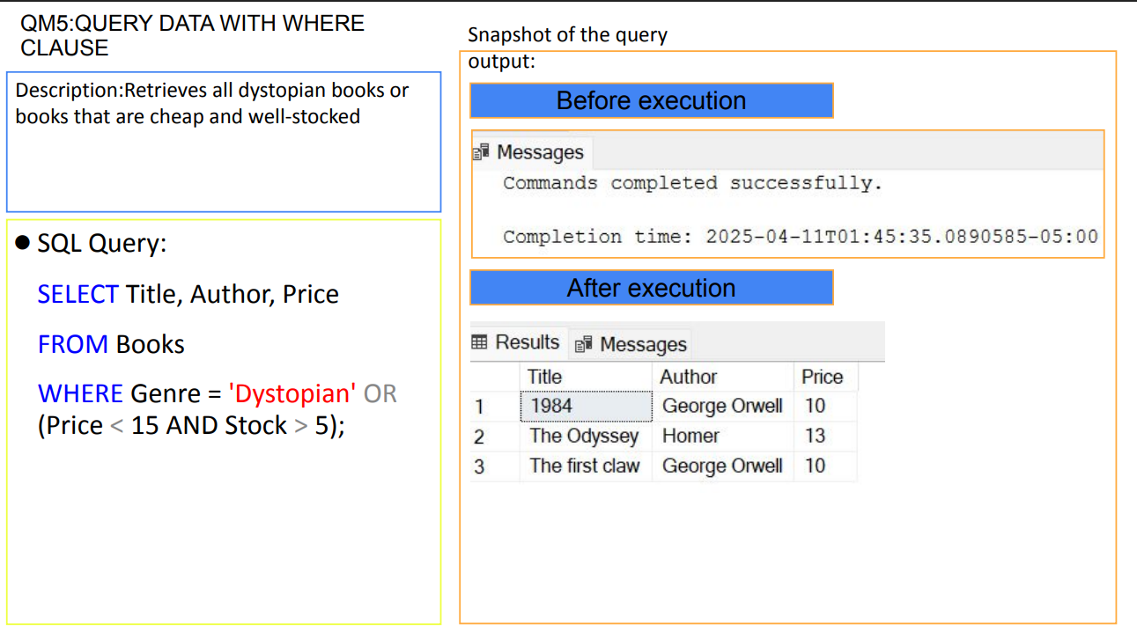

Slide 22
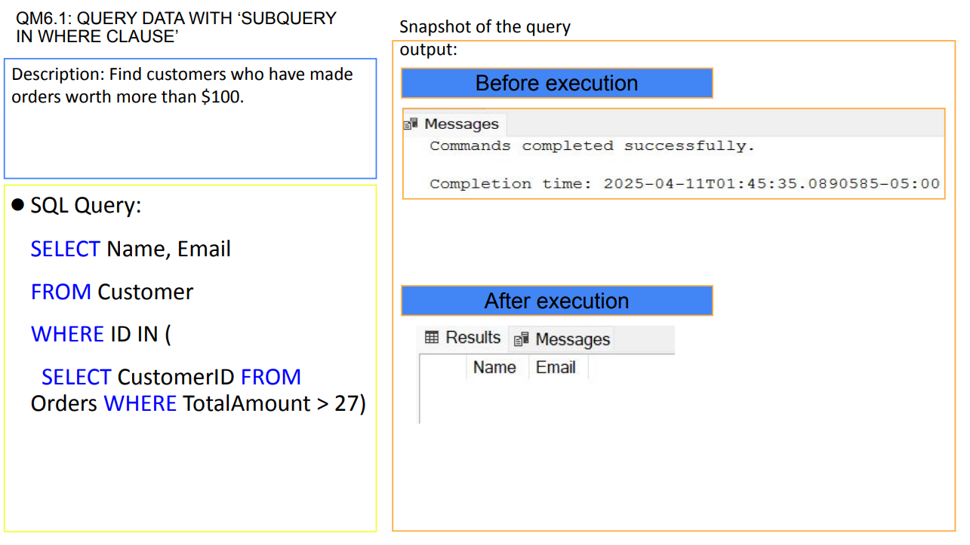

Slide 23
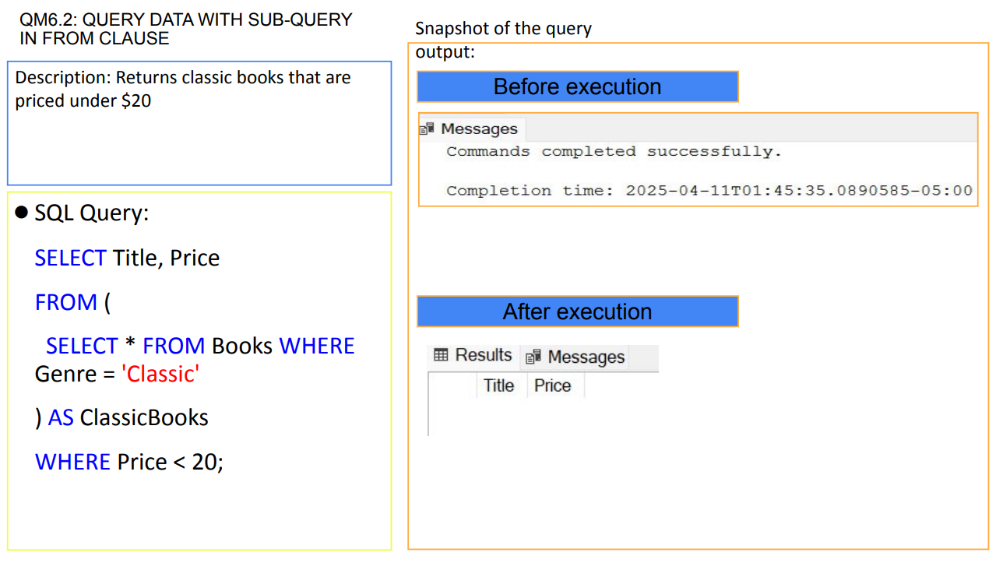

Slide 24
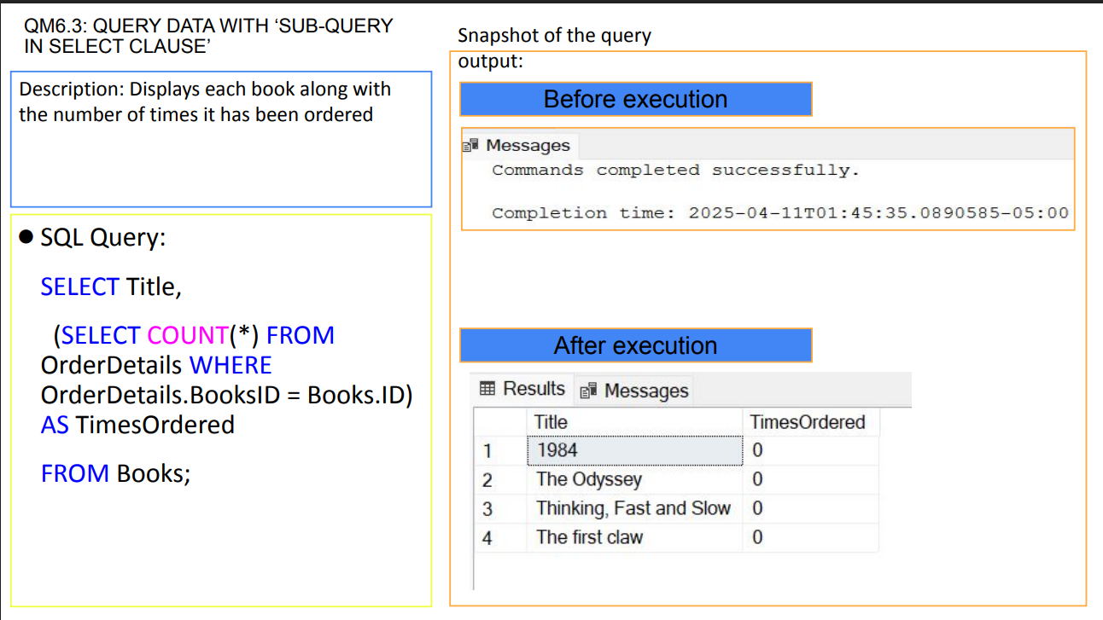

Slide 25
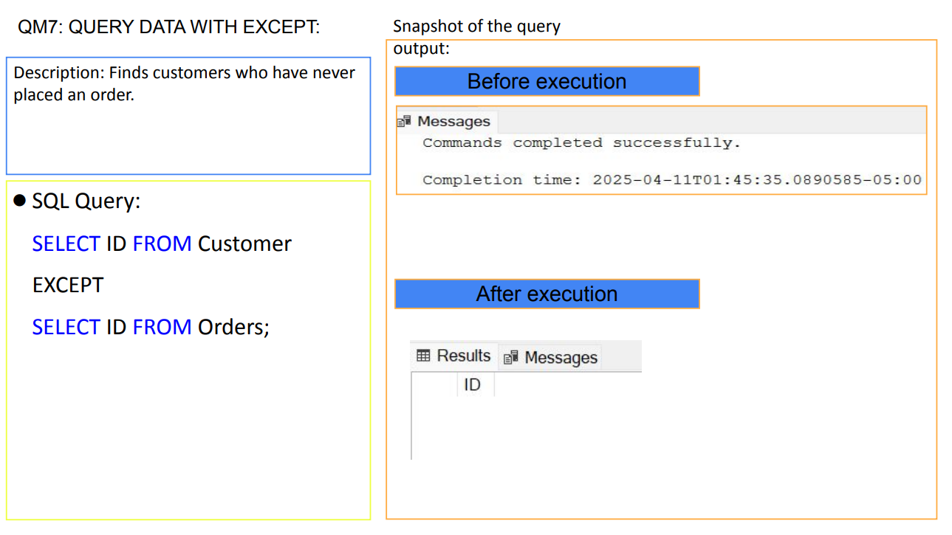

Slide 26
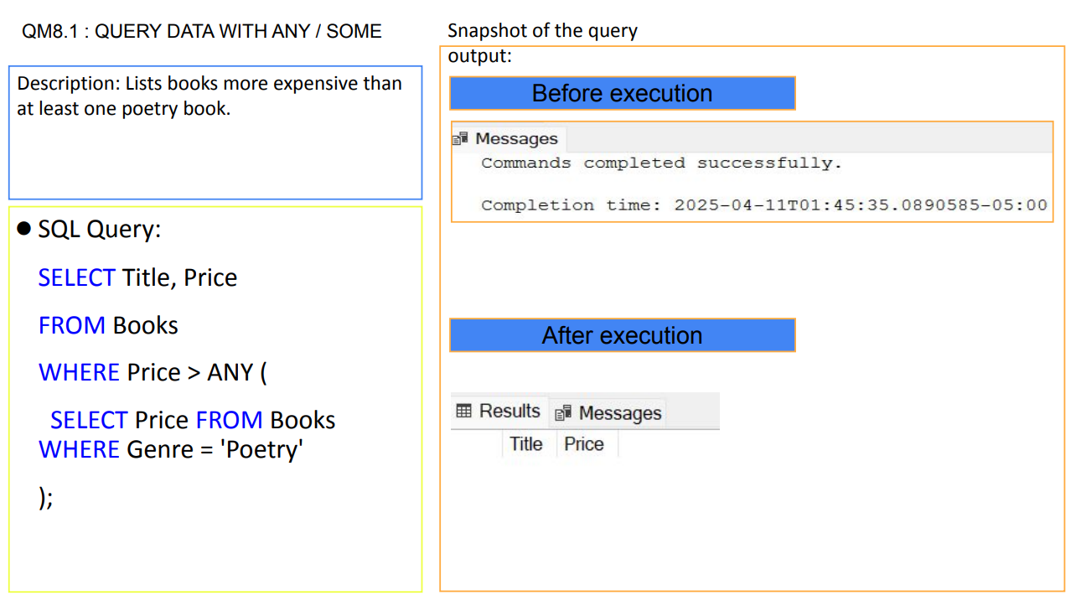

Slide 27
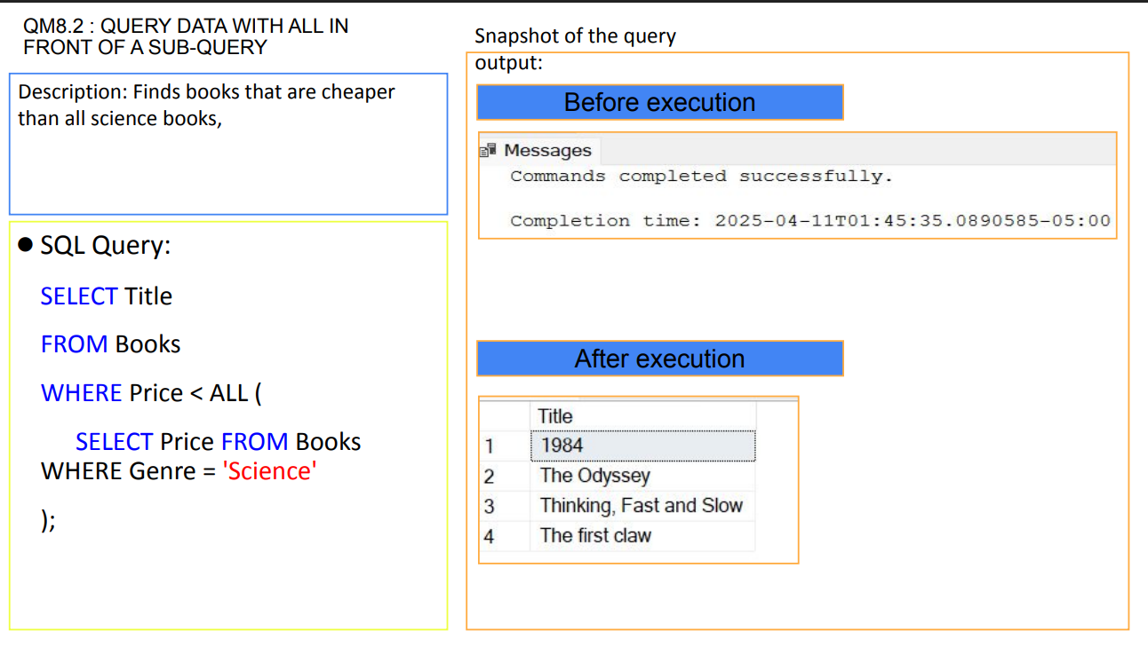

Slide 28
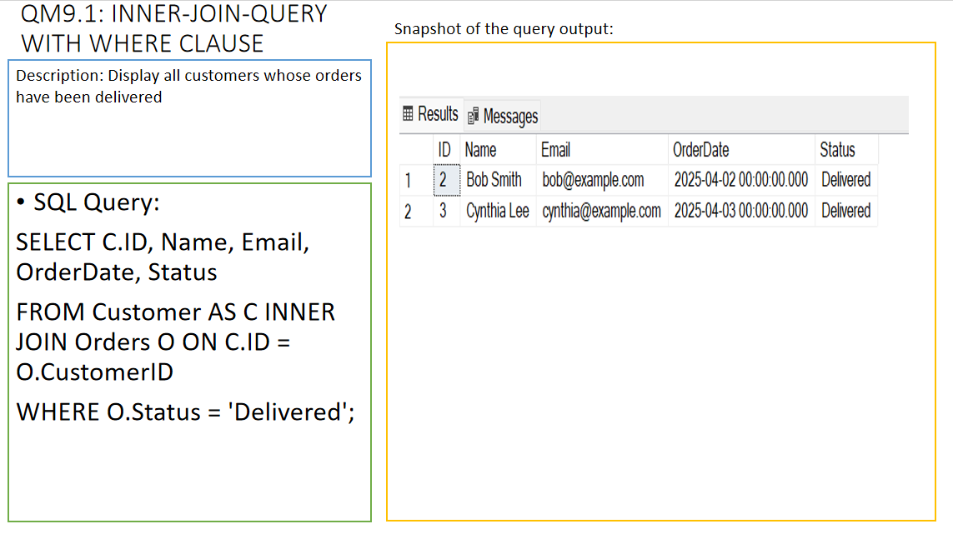

Slide 29
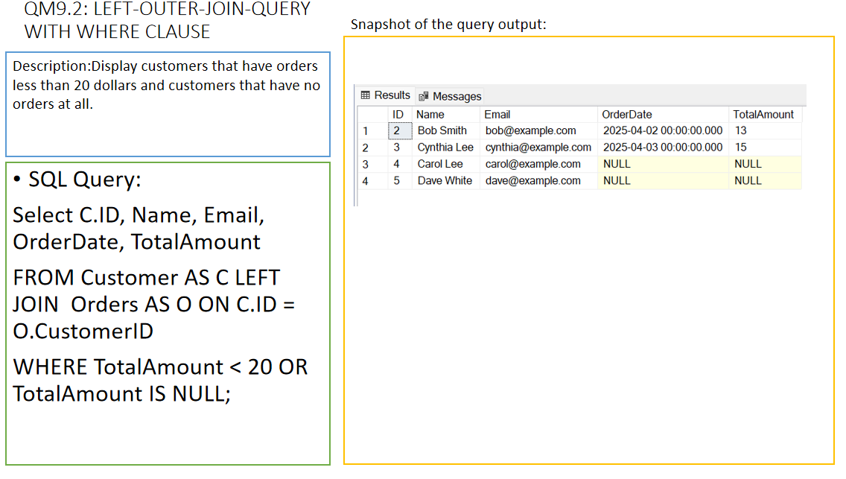

Slide 30
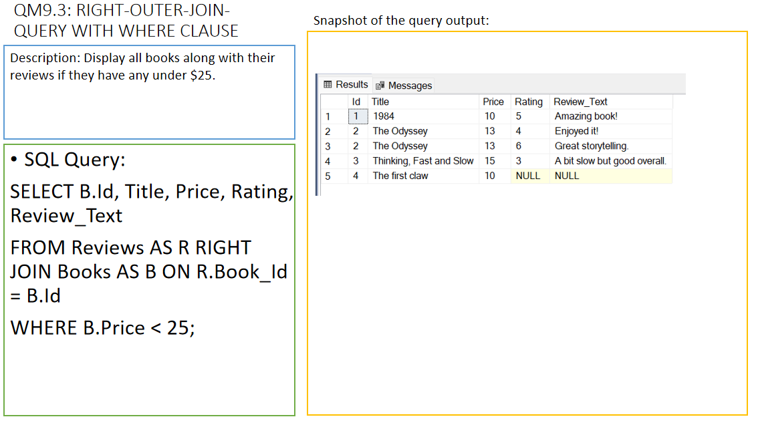

Slide 31
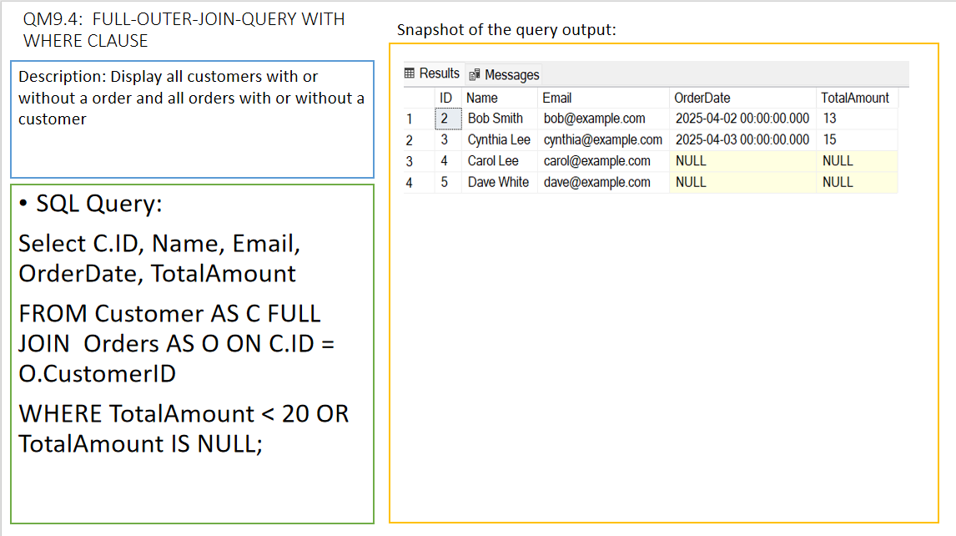

Slide 32
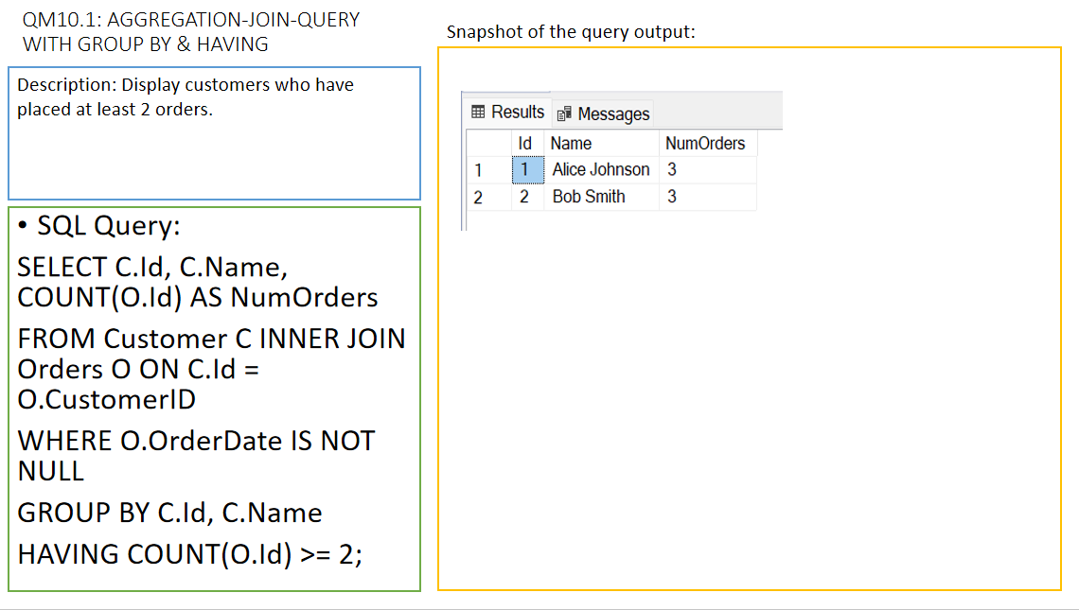

Slide 33
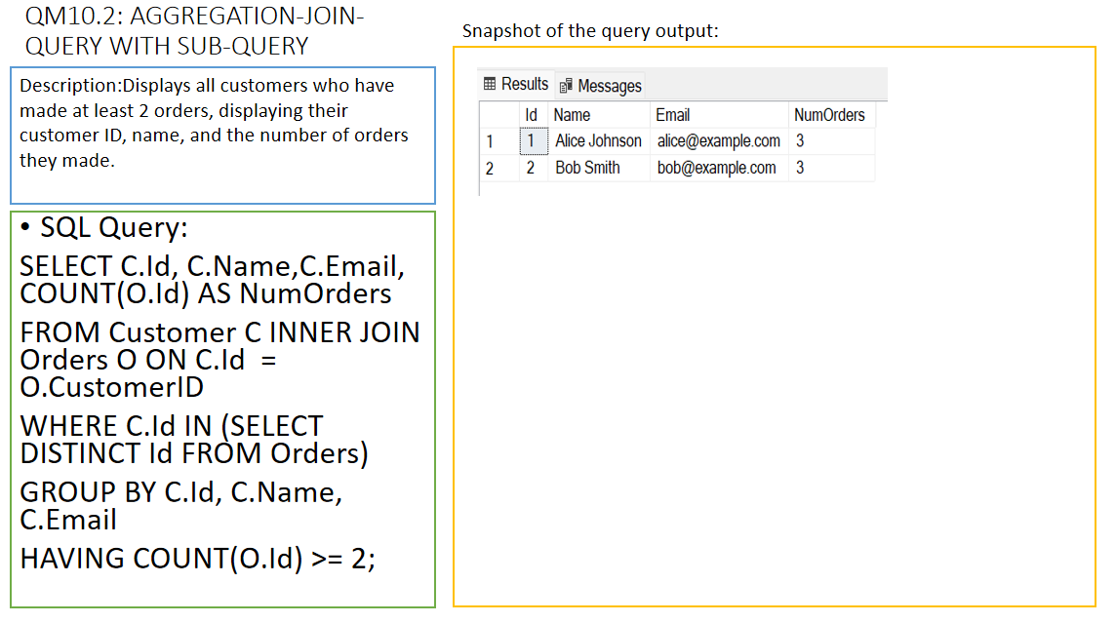

Slide 34
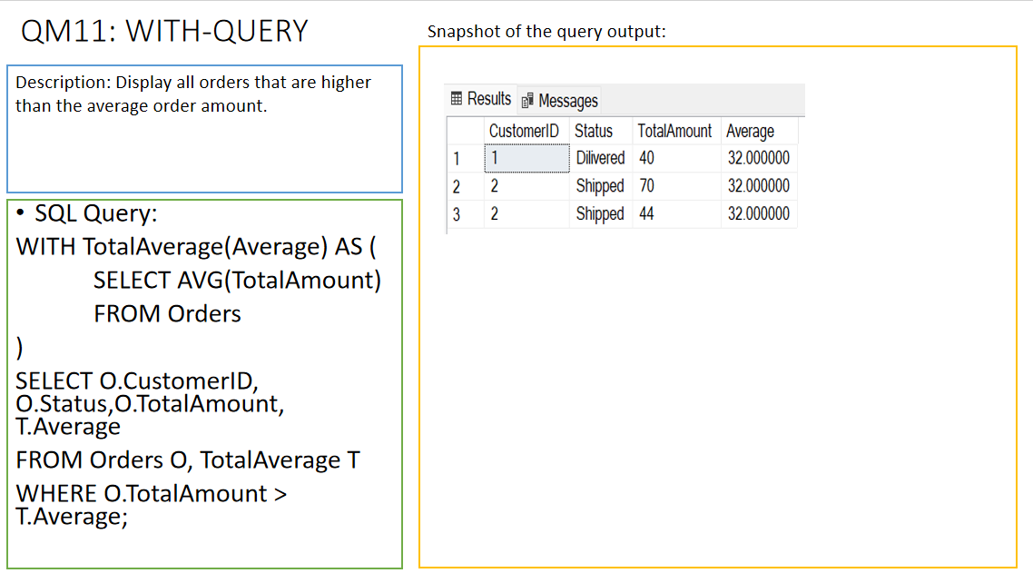

Slide 35
ANALYSIS OF DATA
Discuss Functional Dependencies

Slide 36
2NF
Functional Dependencies:
Full Dependency (FD-type): {Customer ID, Preferred Genre, Loyalty Points} → {Gender, Date of Birth}
Partial Dependency (PD-type): {Customer ID} → {Gender, Date of Birth}
After Normalization:
CUSTOMER PROFILE TABLE
Before Normalization:
CUSTOMER PROFILE TABLE
Customer_Id | DOB | Gender
1 | 1991-01-15 | Female
2 | 1992-02-15 | Male
Customer_Id | DOB | Gender | Preferred Genre | Loyalty Points
1 | 1991-01-15 | Female | Science | 100
2 | 1992-02-15 | Male | Romance | 120
After Normalization:
LOYALTY TABLE
Customer_Id | Pref_Genre | Loyalty_poitns
1 | Science | 100
2 | Romance | 120
Reason: Removed partial dependency.

Slide 37
3NF
Transitive Dependency:
FD-type: {OrderID} → {CustomerID} → {Customer Details}
Transitive dependency: Order_Id → Book_Id → Payment Info
Before:
Payment info was tied to Order_Id and Book_Id → creating transitive dependency.
After:
Removed Book_Id from Payments table → Now, Payment is directly linked only to Order_Id.
Before Normalization:
PAYMENTS TABLE
Id | Order_Id | Book_Id | Payment_method | Payment_Date | Payment_amount
1 | 12 | 5 | Bank Transfer | 1/29/2025 | 135.81
2 | 7 | 2 | Bank Transfer | 2/22/2025 | 145.32
After Normalization: PAYMENTS TABLE
After Normalization: ORDER DETAILS TABLE
Id | Order_Id | Payment_method | Payment_Date | Payment_amount
1 | 12 | Bank Transfer | 1/29/2025 | 135.81
2 | 7 | Bank Transfer | 2/22/2025 | 145.32
Id | Order_Id | Book_Id | Quantity | Subtotal
1 | 12 | 5 | 4 | 4.99
2 | 7 | 2 | 7 | 12.65
Reason: Removed transitive dependency.

Slide 38
ANALYSIS OF DATA
Discuss Possible Anomalies and Remedies
Instructions:
Provide some sample tuples of your database to discuss possible anomaly issues related to data insertion, update, delete anomalies existing in your database. If does not exist, then add some sample tuples to your tables in your database so that an insertion, an update, and a delete anomaly exist.
Propose remedies with some examples for anomalies existing in the database.

Slide 39
Update Anomaly
Update Anomaly
Sample Data: CUSTOMER_TABLE and LOYALTY_TABLE (Preferred Genre and Loyalty Points inconsistencies)
Explanation: If "Preferred Genre" or "Loyalty Points" is updated in one record but not others, inconsistency arises.
Remedy:
Split tables (2NF done)
Update happens only in LOYALTY_TABLE.

Slide 40
Insertion Anomaly
Sample Data: ORDERS_TABLE trying to insert Order without existing CUSTOMER_TABLE entry.
Explanation:
Cannot insert Order unless Customer exists.
Remedy:
Insert Customer first.
Enforce foreign key constraints.

Slide 41
Deletion Anomaly
Update Anomaly
Sample Data: Deleting Customer causes orphan Orders.
Explanation:
Orders lose reference if Customer is deleted.
Remedy:
Use "ON DELETE CASCADE" carefully.
Archive Customer data instead of deleting.

Slide 42
Credits and References
W3 schools:
https://www.w3schools.com/sql/sql_alter.asp
MDN Web Docs:
https://www.geeksforgeeks.org/sql-trigger-student-database/
Programmiz online SQL compiler:
https://www.programiz.com/sql/online-compiler

